Slide 1
COVID-19 Statistics
17-05-2020

Slide 2
Latest Statistics
(updated 17-05-2020)
Total confirmed cases worldwide: 4,712,899
79,552 new cases (1% increase)
Total fatal cases worldwide: 315,170
3,404 new fatalities (1% increase)
Israel recorded 16,617 cases in total
increased by 9 cases (0% increase)
35.0# in confirmed cases, 43.0# in mortality
33.0# in cases per capita, 40.0# in mortality rate

Slide 3
Latest Statistics
(updated 17-05-2020)
Worldwide mortality rate: 6.7% (-0.0%)
Israel mortality rate: 1.6% (+0.0%)
US has most cases in total (1,486,757)
US has most fatal cases in total (US)
US recorded the most new cases (18,937)
US recorded the most new fatal cases (808)

Slide 4
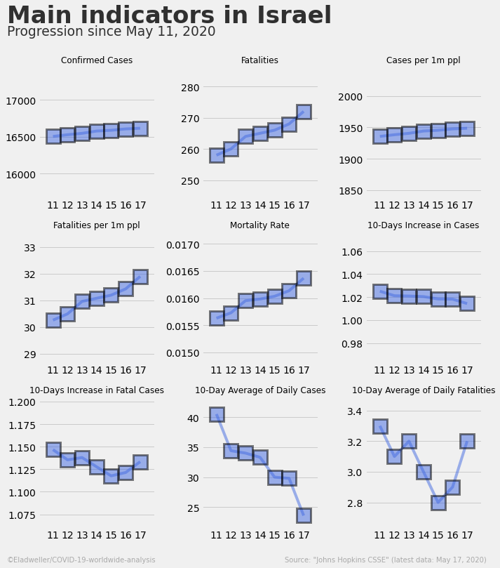

Slide 5
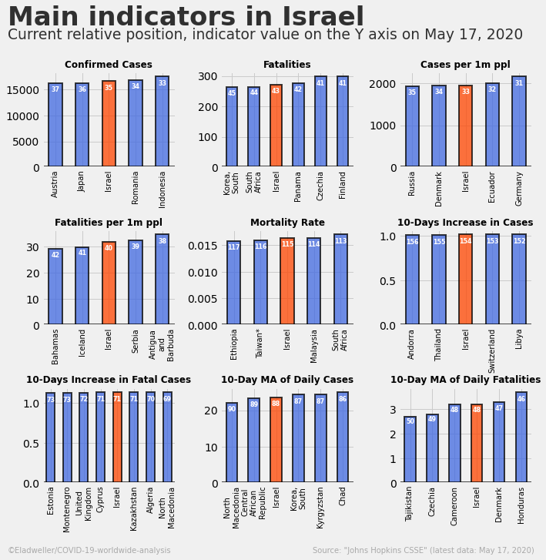

Slide 6
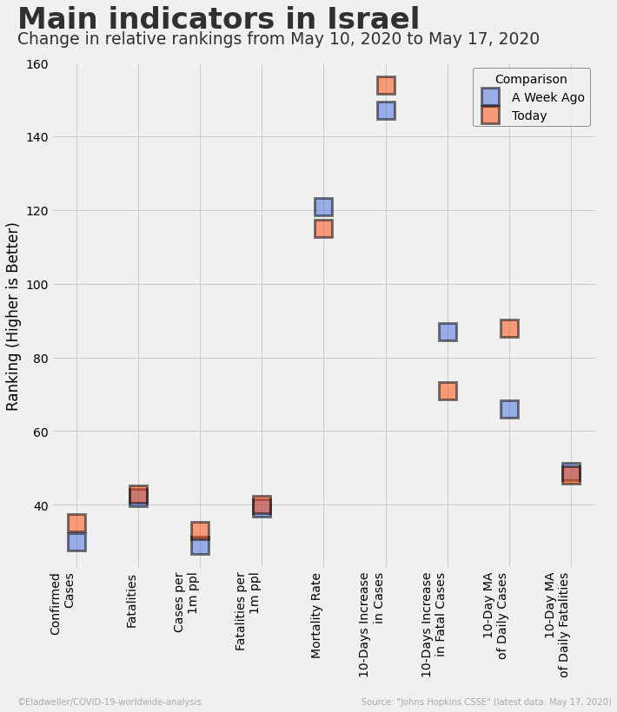

Slide 7
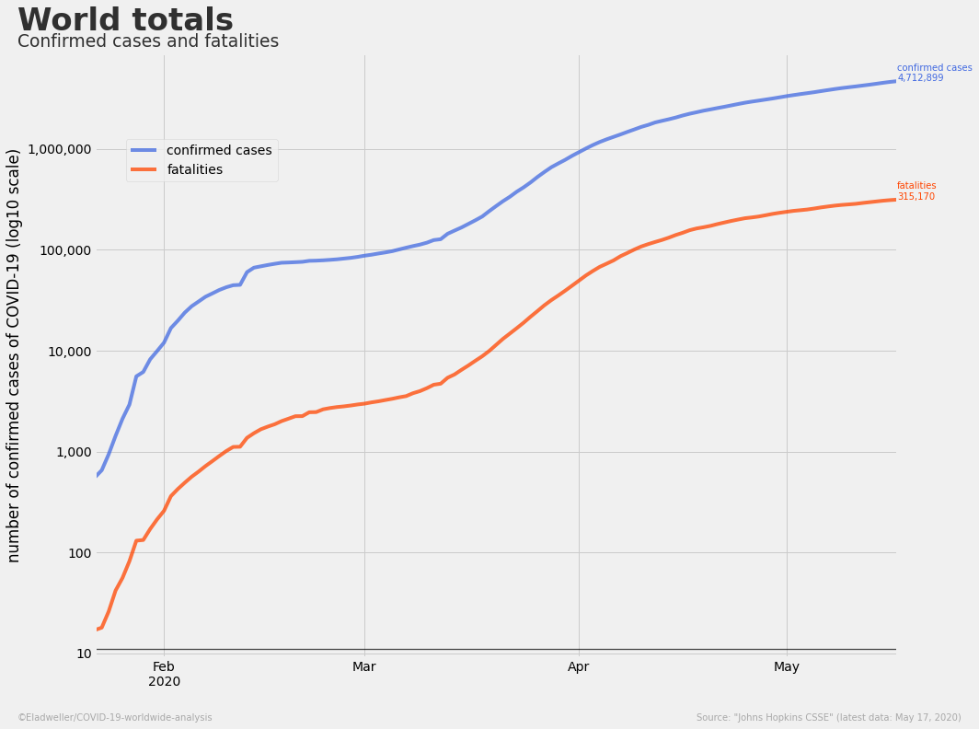

Slide 8
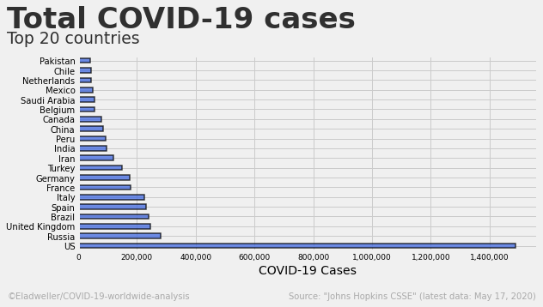

Slide 9
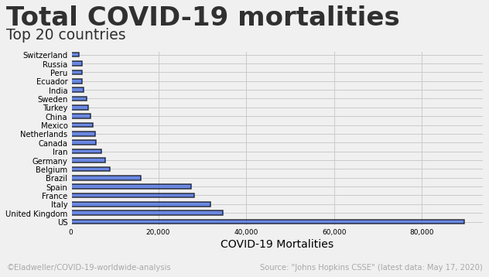

Slide 10
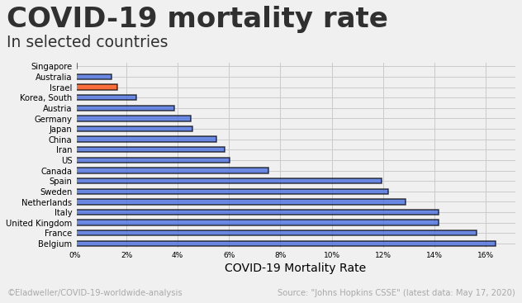

Slide 11
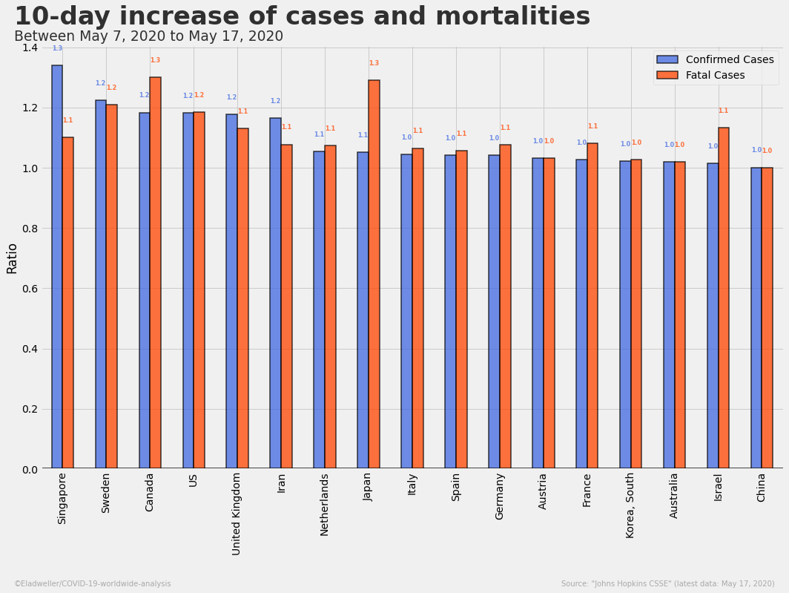

Slide 12
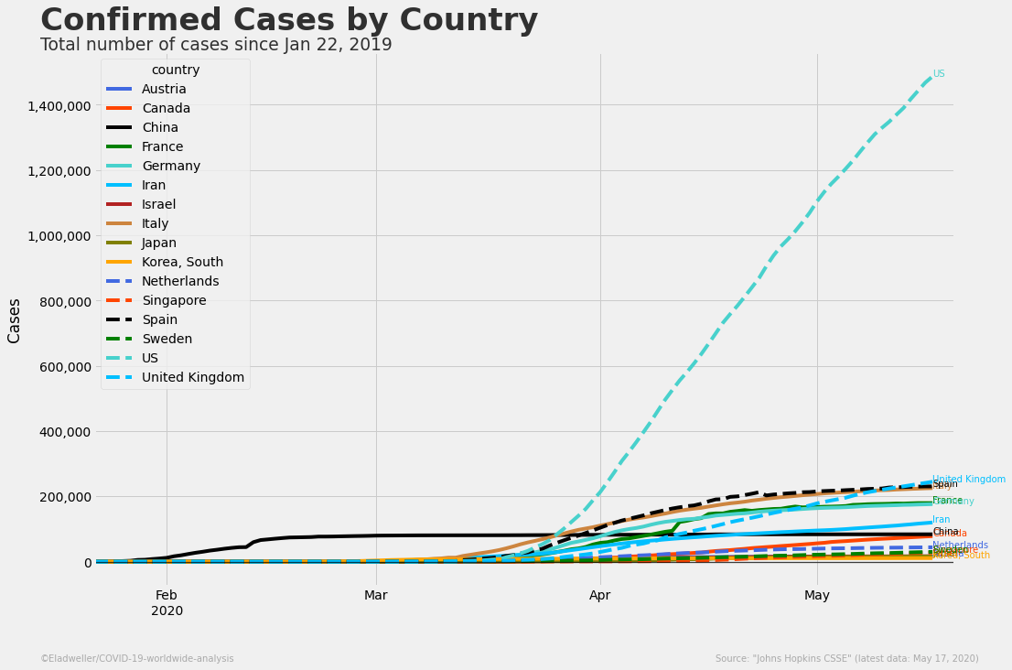

Slide 13
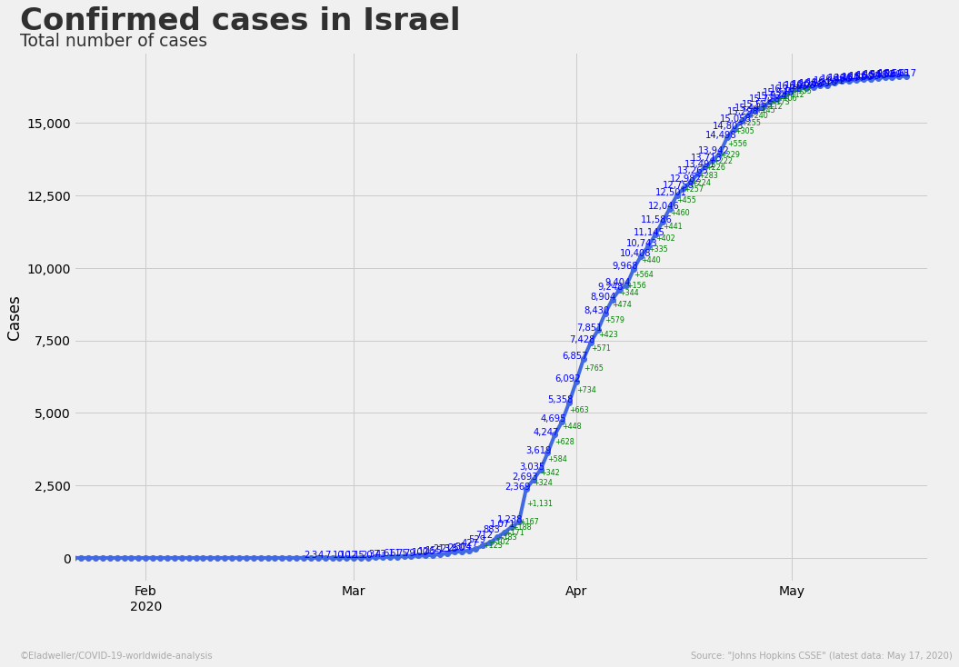

Slide 14
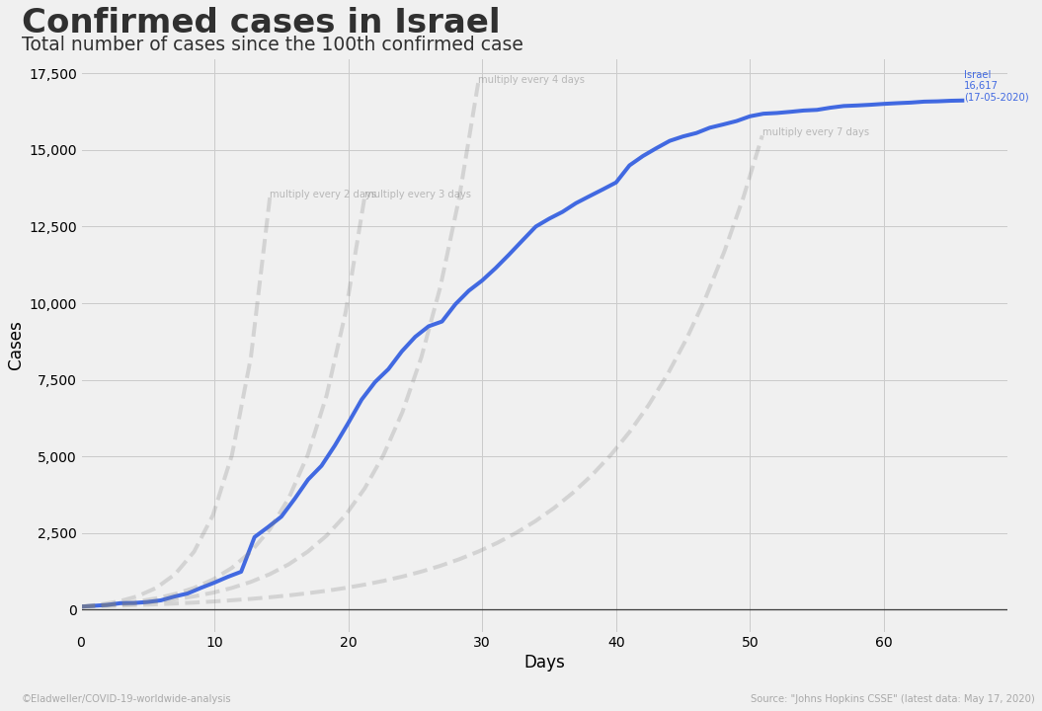

Slide 15
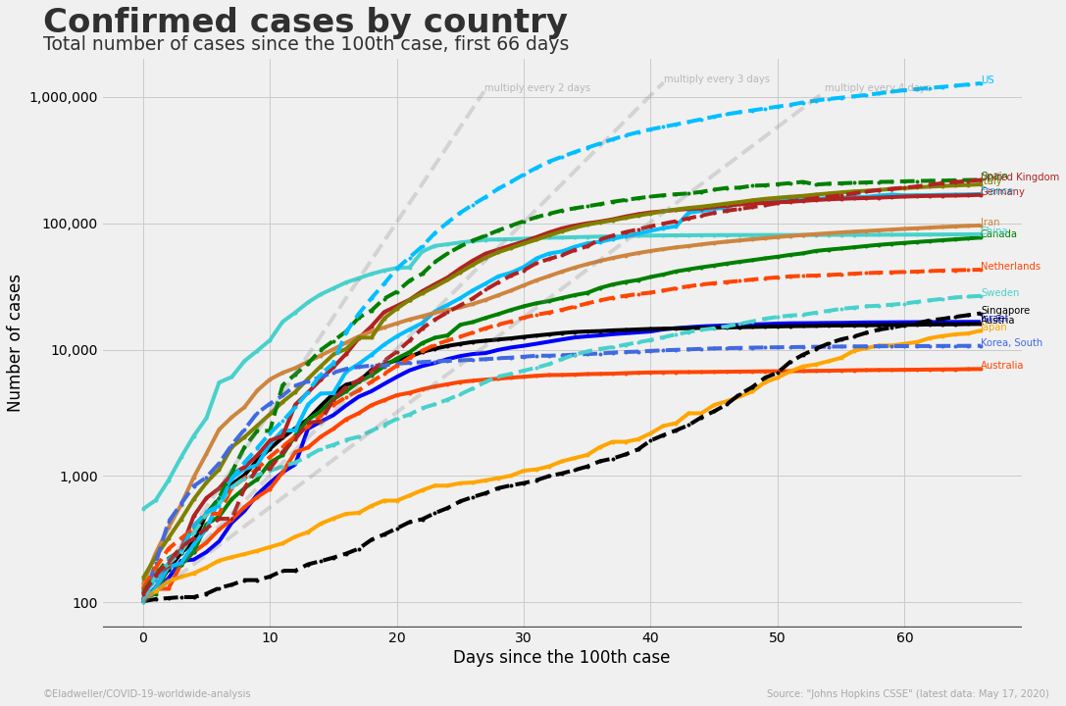

Slide 16
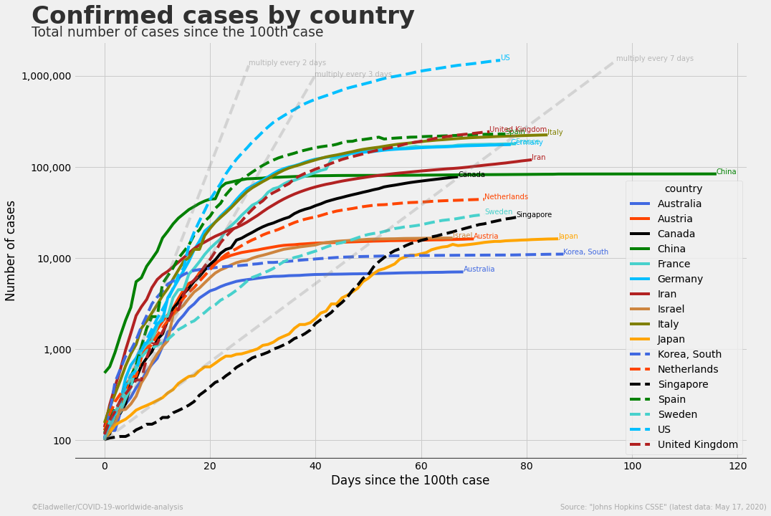

Slide 17
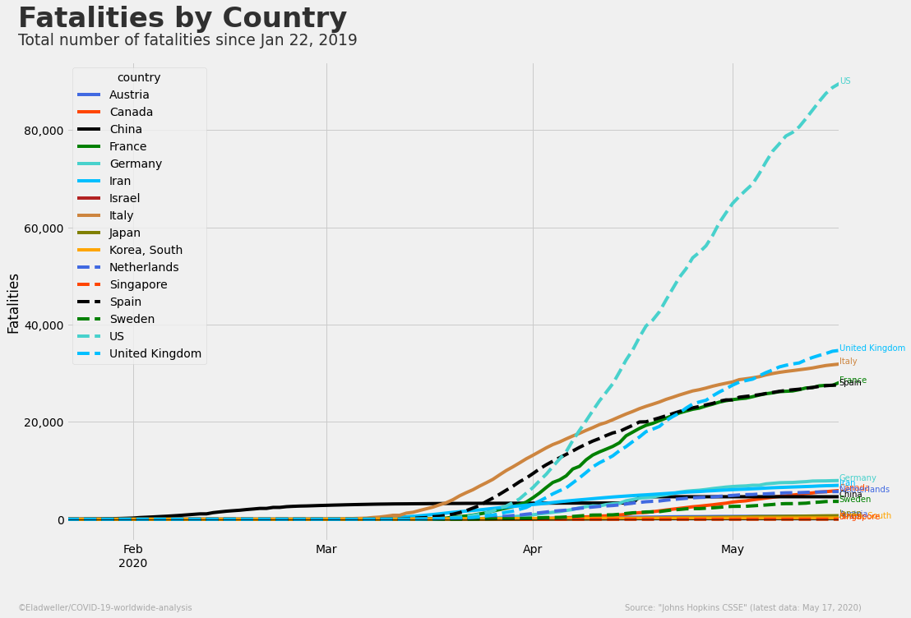

Slide 18
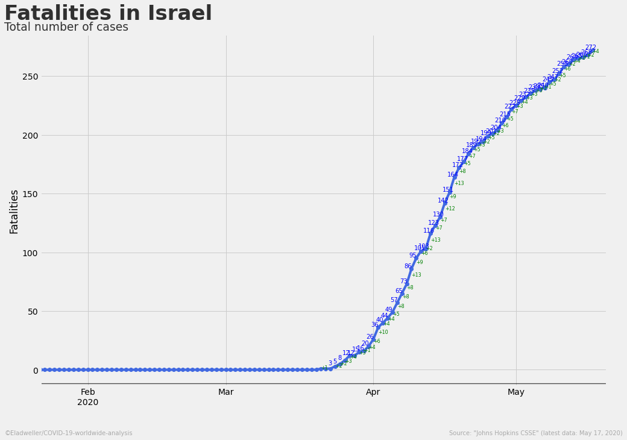

Slide 19
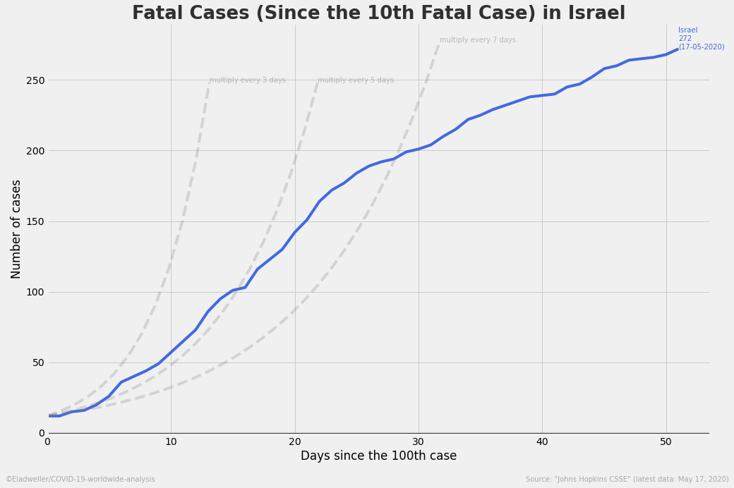

Slide 20
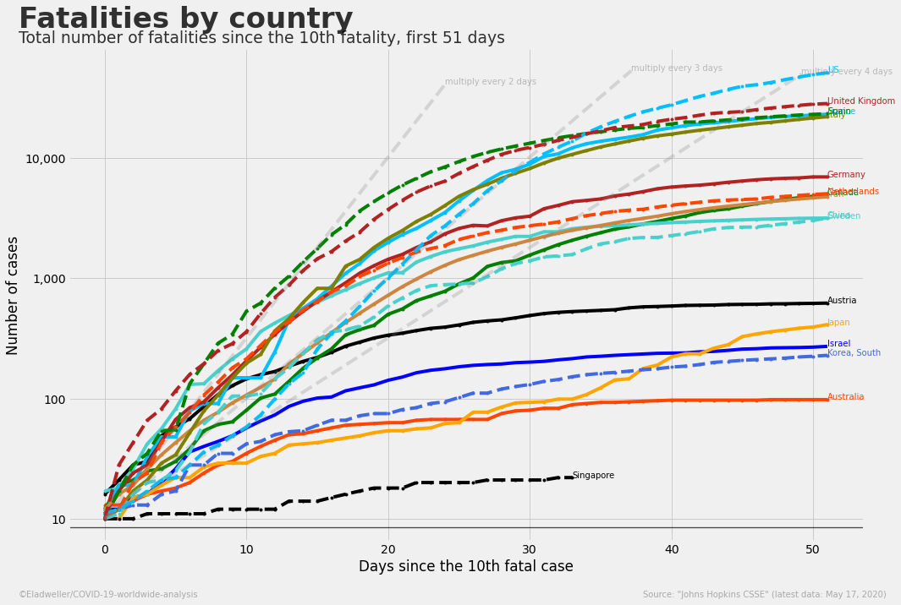

Slide 21
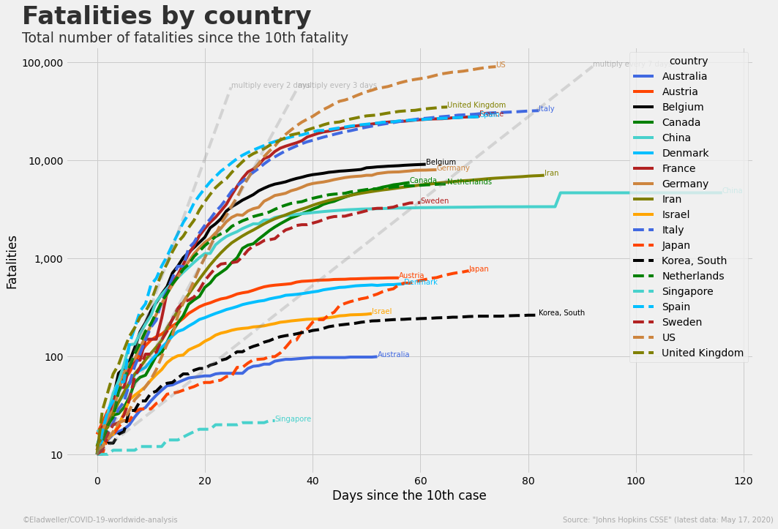

Slide 22
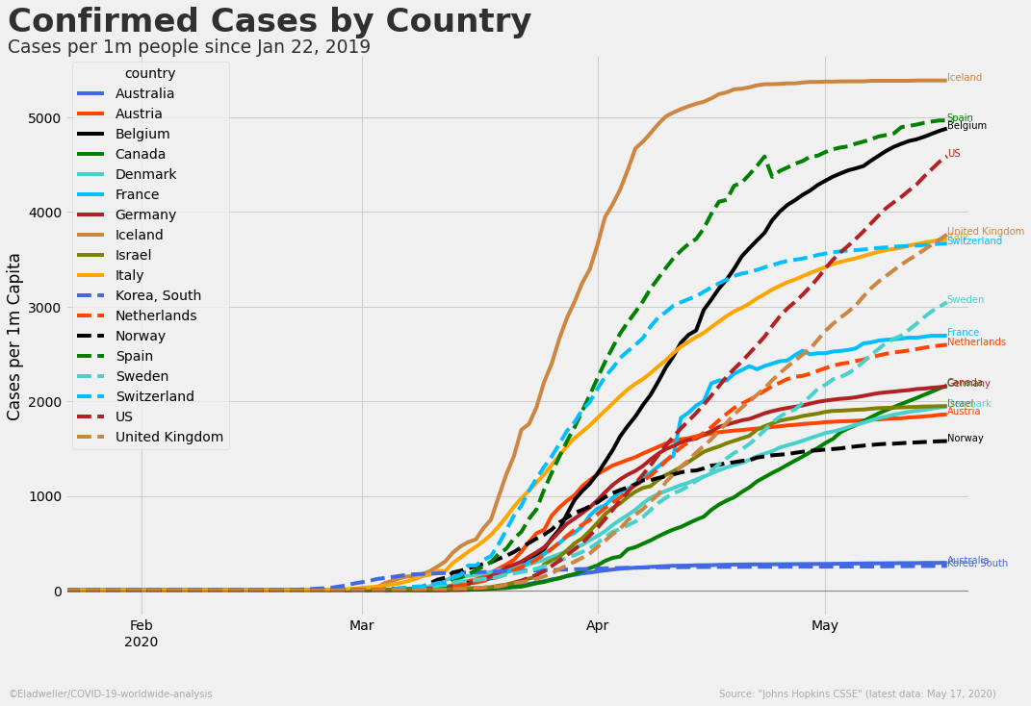

Slide 23
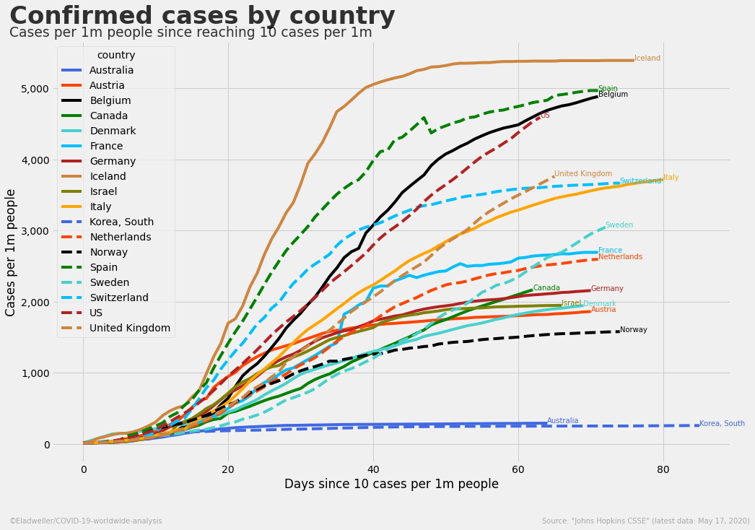

Slide 24
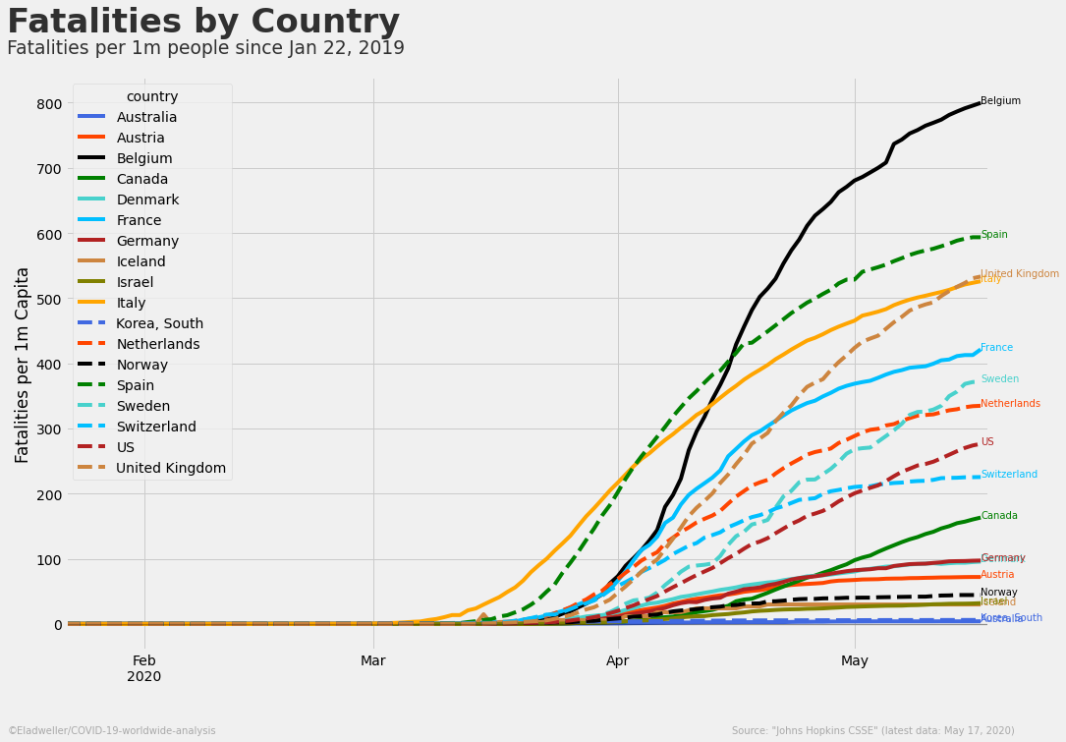

Slide 25
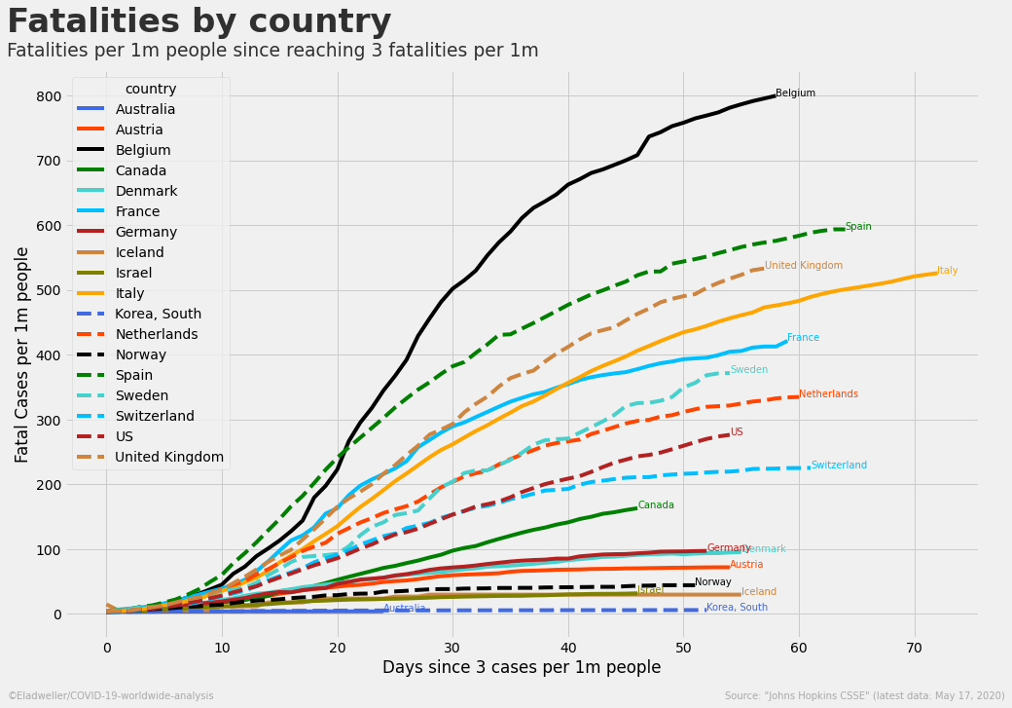

Slide 26
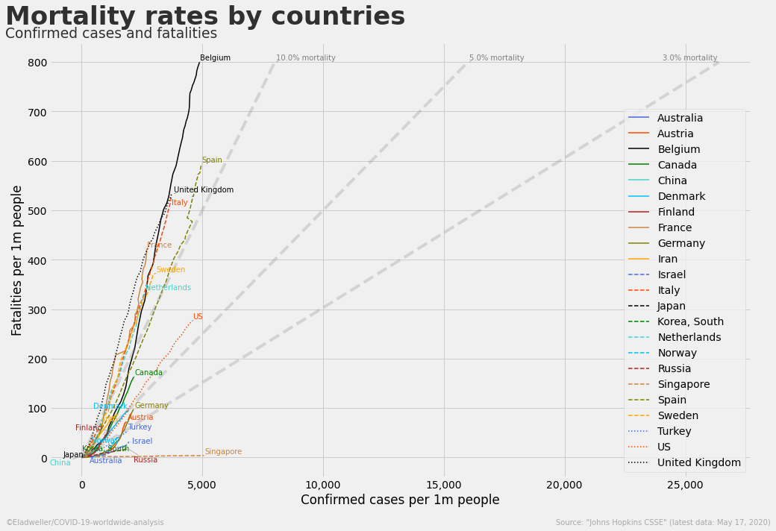

Slide 27
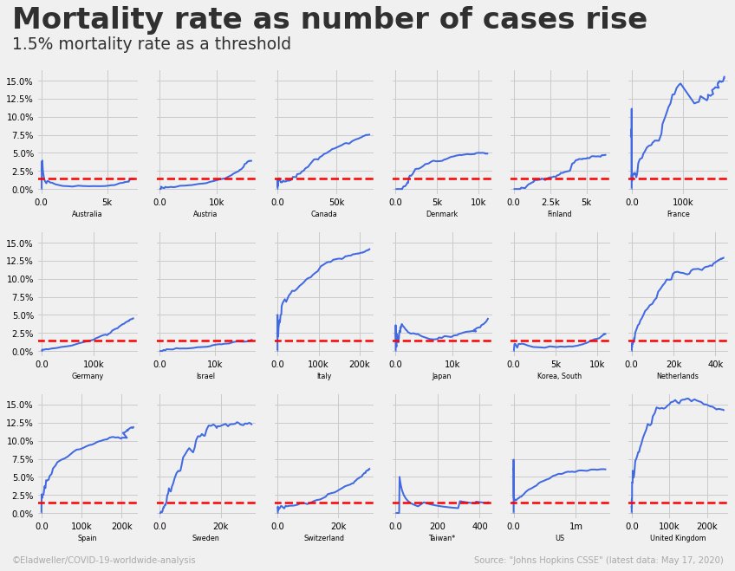

Slide 28
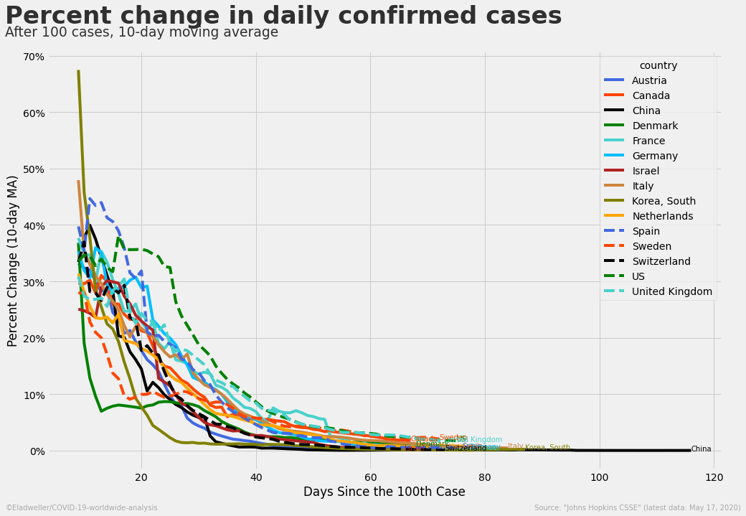

Slide 29
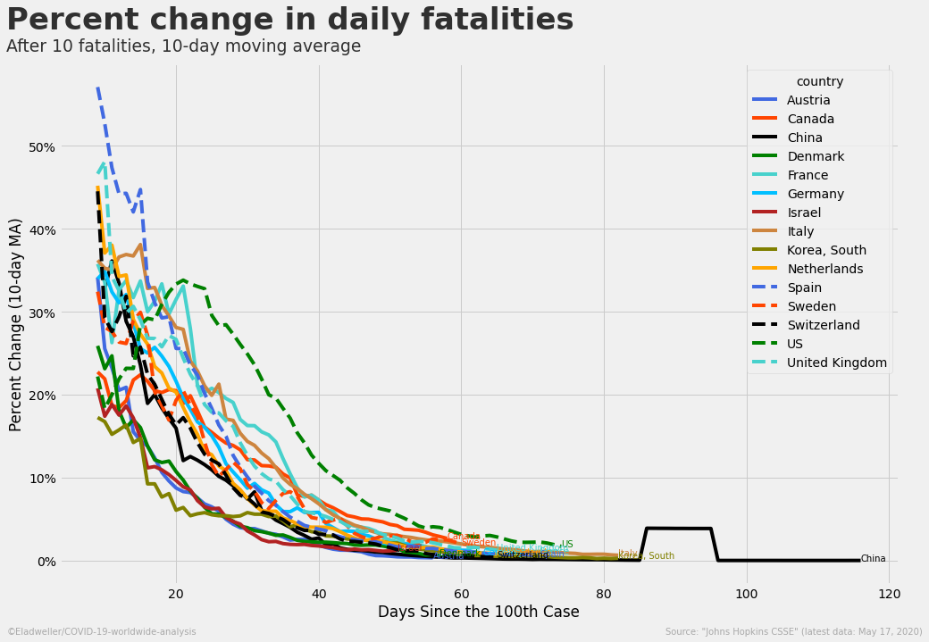

Slide 30
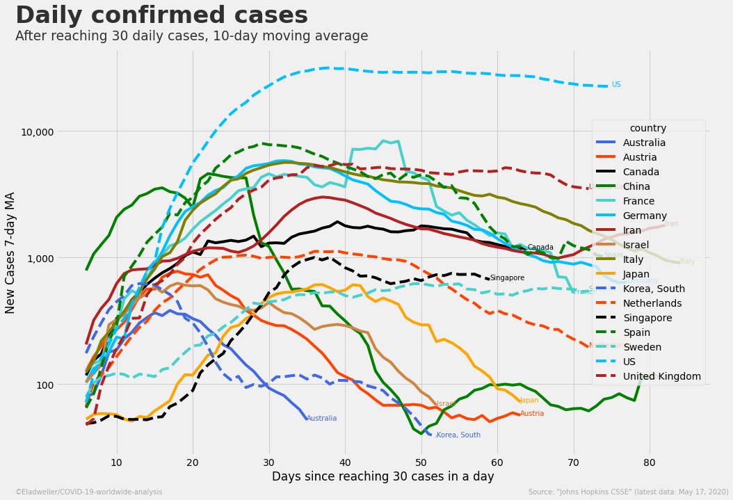

Slide 31
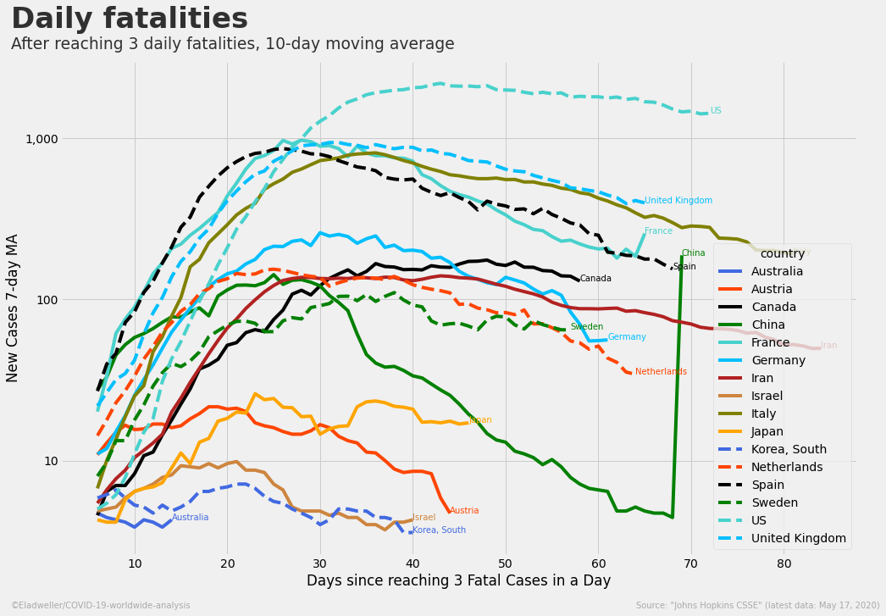

Slide 32
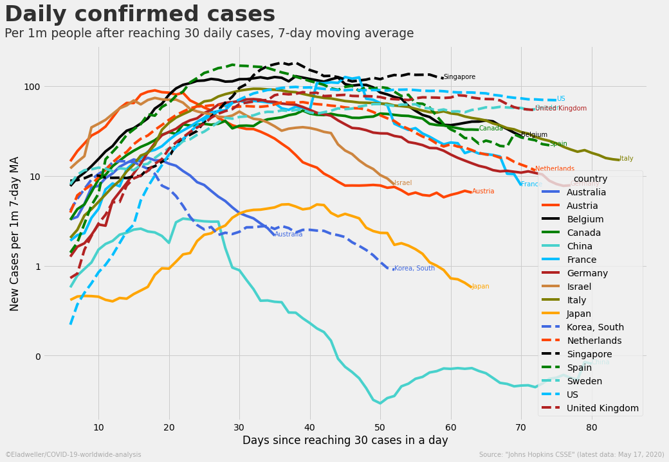

Slide 33
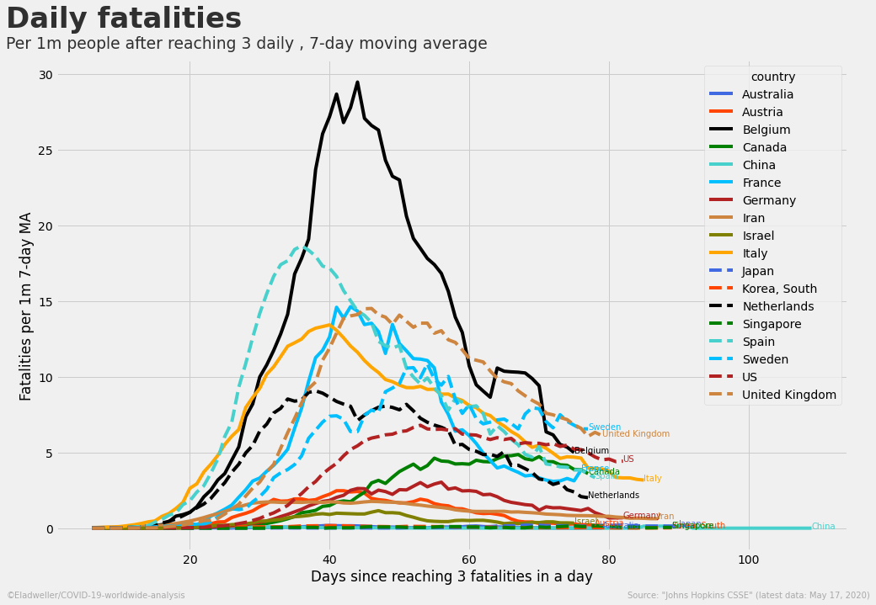

Slide 34
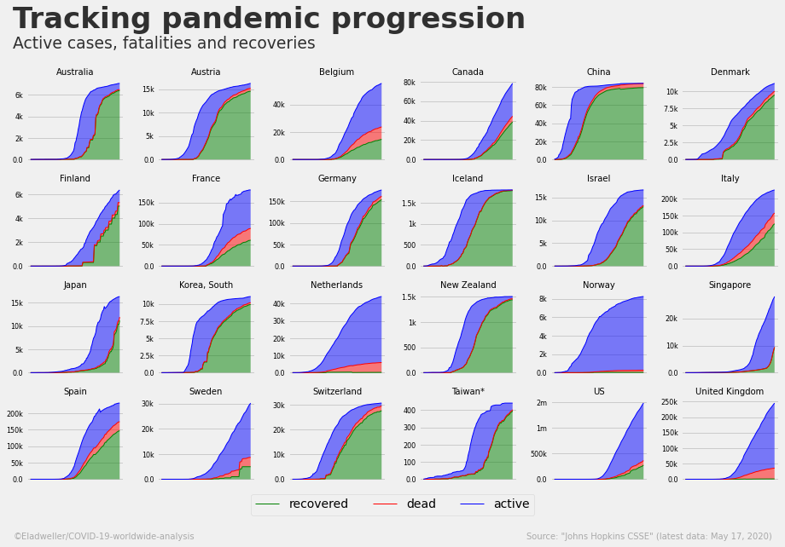

Slide 35
